Slide 1
(53:9-11)

Slide 2
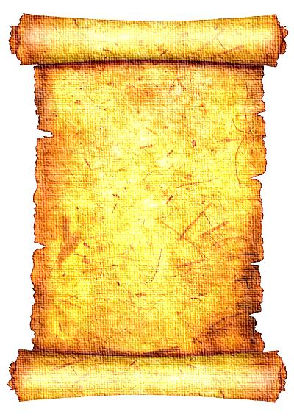
“BECAUSE”
“And they made His grave with the wicked—But with the rich at His death, Because He had done no violence, Nor was any deceit in His mouth.”
Isaiah 53:9

Slide 3
“OFFERING”
“Yet it pleased the LORD to bruise Him; He has put Him to grief. When You make His soul an offering for sin, He shall see His seed, He shall prolong His days, And the pleasure of the LORD shall prosper in His hand.”
Isaiah 53:10

Slide 4
“Pleased The Lord”
The “wrath of God” is not mentioned here, but rather “the pleasure of the Lord” shall prosper in His hand
Correct sacrifices please the Lord (Lev. 1:9; contrast, Gen. 4:4, 5)

Slide 5
What Pleased The Lord?
Jesus bruised as an offering for our sin
Isaiah 53:10
Suffering wrongfully for what is right
1 Peter 2:19-21
Jesus Christ’s ministry/death
Matthew 3:17; 17:5; Ephesians 5:2; John 8:29; Hebrews 1:8, 9

Slide 6
Spiritual Death?
Soul was an offering for sin (53:10)
Poured out unto death (53:12)
Meaning: the giving of His life unto death (cf. Gen. 35:18, Lk. 23:46)
Emphasis: death of body not spirit (Lk. 22:19; Jn. 6:51; Rom. 7:4; Eph. 2:15; Heb. 10:10; etc.)

Slide 7
“LABOR”
“He shall see the labor of His soul, and be satisfied. By His knowledge My righteous Servant shall justify many, For He shall bear their iniquities.”
Isaiah 53:11

Slide 8
Why You Need To Know Jesus
Because there is power in His blood (Heb. 10:19-22)
Because there is salvation in no one else (Acts 4:12)
Because He is the only way to the Father (Jn. 14:6; Jn. 10:9)

Slide 9
Why You Need To Know Jesus
Because He saves only those who obey Him (Heb. 5:9)
Because He is coming a second time to bring salvation (Heb. 9:28)
So that He will know you (Matt. 7:21-23; 2 Tim. 2:19)

